Slide 1
The Relational Database Model

Slide 2
Content
Table
Keys
Integrity rules
Relational set operators
The data dictionary
Relationships within the relational database
Index

Slide 3
A Logical View of Data
The relational model enables you to view data logically rather than physically.

Slide 4
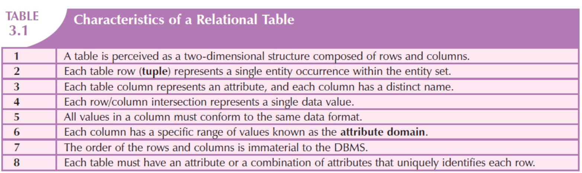
Characteristics of a Relational Table

Slide 5
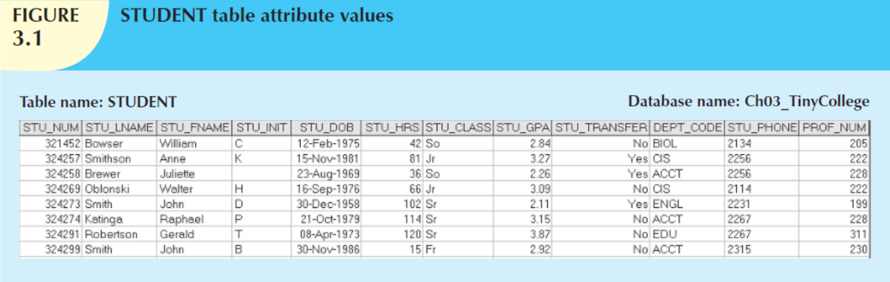
row – tuple
column – attribute
entity set
attribute’s characteristics: numeric, character(text or string), date, logical
domain
the order is immaterial
primary key (PK)

Slide 6
Key
A key consists of one or more attributes that determine other attributes.
The key’s role is based on a concept known as determination.
A determines B
If you know the value of attribute A, you can look up (determine) the value of attribute B.
A → B
A → B, C, D

Slide 7
Functional Dependency
The attribute B is functionally dependent on A, if A determines B.
The attribute B is functionally dependent on the attribute A if each value in column A determines one and only one value in column B.

Slide 8
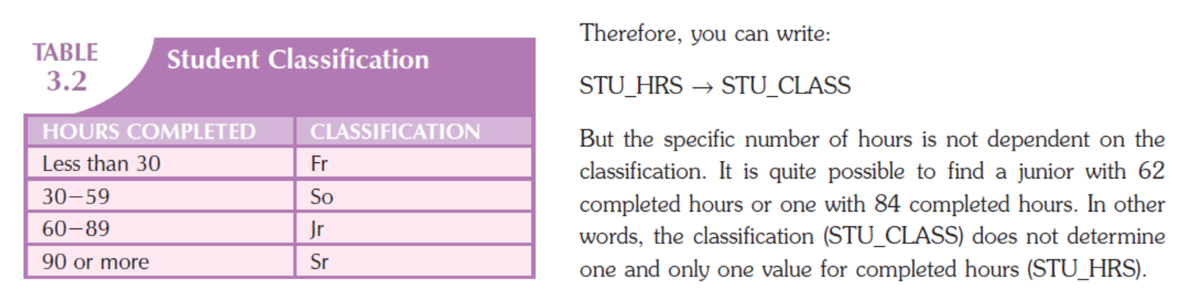

Slide 9
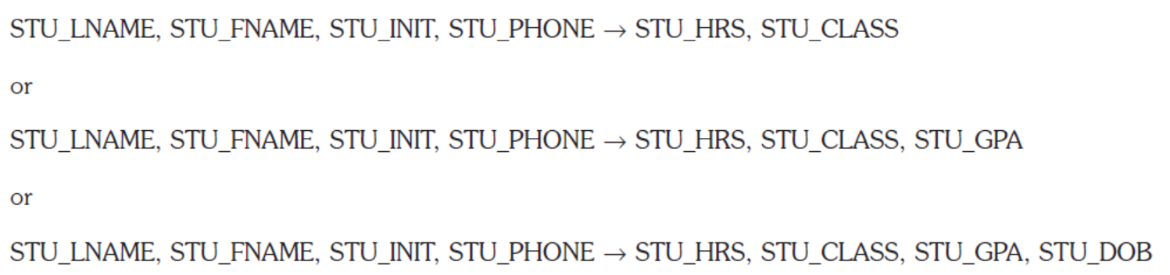
Composite Key
A key may be composed of more than one attribute. Such a multi-attribute key is known as a composite key.
Any attribute that is part of a key is known as a key attribute.

Slide 10
Full Functional Dependence
If the attribute (B) is functionally dependent on a composite key (A) but not on any subset of that composite key, the attribute (B) is fully functionally dependent on (A).

Slide 11
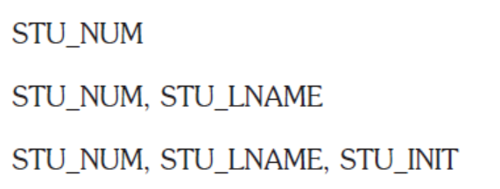
Superkey
Any key that uniquely identifies each row.
The superkey functionally determines all of a row’s attributes.

Slide 12
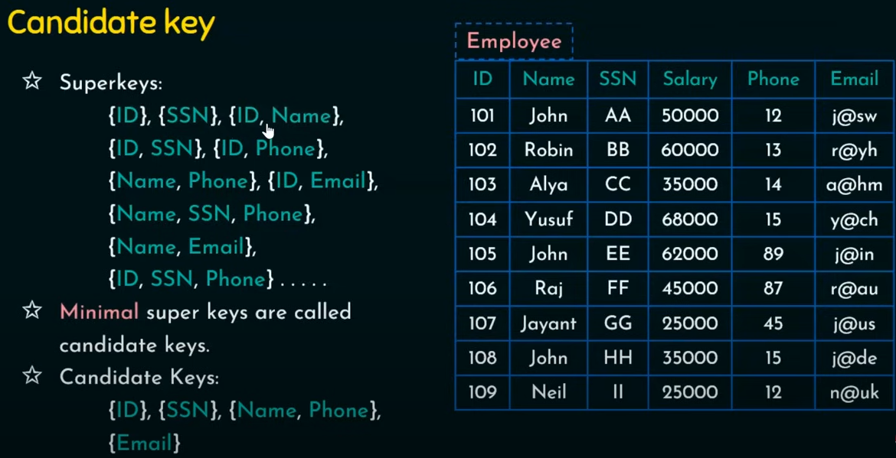
Candidate key
A candidate key can be described as a superkey without unnecessary attributes, that is, a minimal superkey.
Example: Employee Table

Slide 13
Primary key
Within a table, each primary key value must be unique to ensure that each row is uniquely identified by the primary key.
In that case, the table is said to exhibit entity integrity.
To maintain entity integrity, a null (that is, no data entry at all) is not permitted in the primary key.

Slide 14
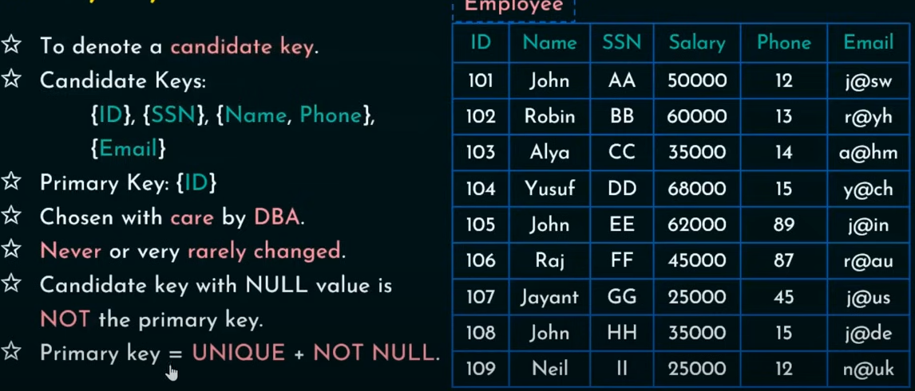
Primary Key (Cont...)

Slide 15
Relational schema
A relational schema is a textual representation of the database tables where each table is listed by its name followed by the list of its attributes in parentheses.
The primary key attribute(s) is (are) underlined.

Slide 16
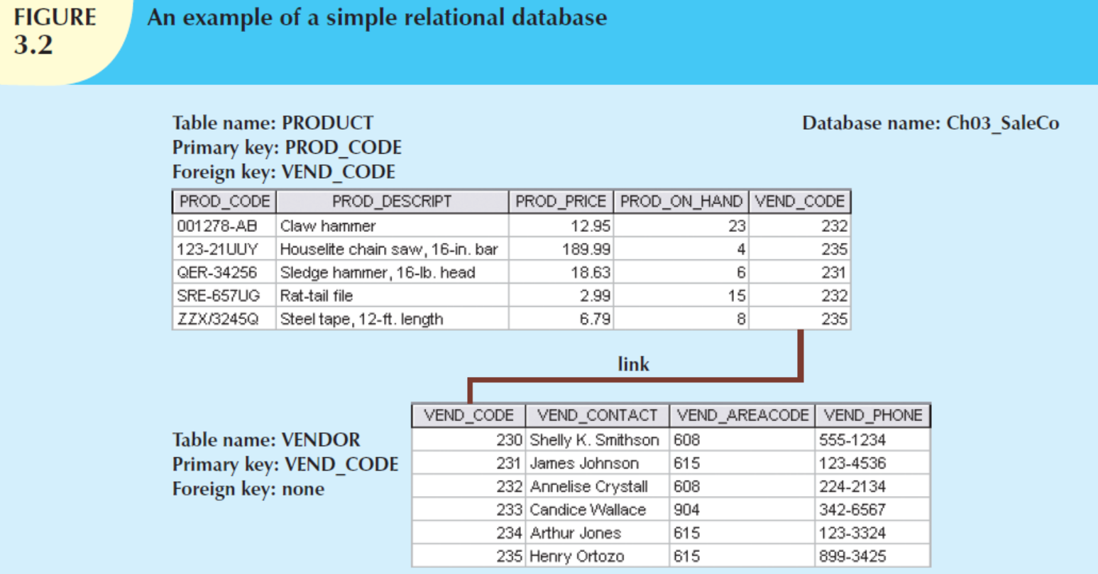
VENDOR (VEND_CODE, VEND_CONTACT, VEND_AREACODE, VEND_PHONE)
PRODUCT (PROD_CODE, PROD_DESCRIPT, PROD_PRICE, PROD_ON_HAND, VEND_CODE)

Slide 17
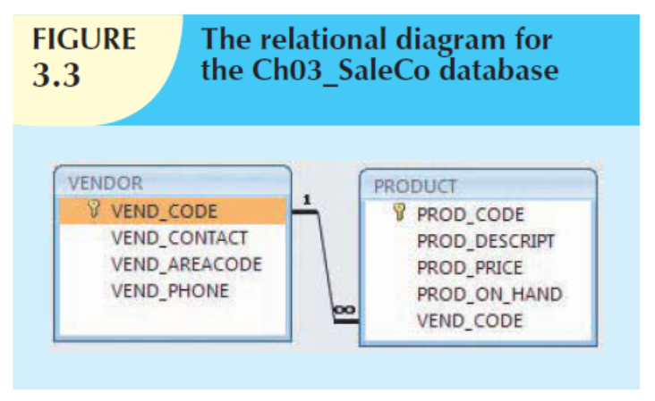
Foreign key
A foreign key (FK) is an attribute whose values match the primary key values in the related table.

Slide 18
Secondary key
A secondary key is defined as a key that is used strictly for data retrieval purposes.
A secondary key’s effectiveness in narrowing down a search depends on how restrictive that secondary key is.

Slide 19
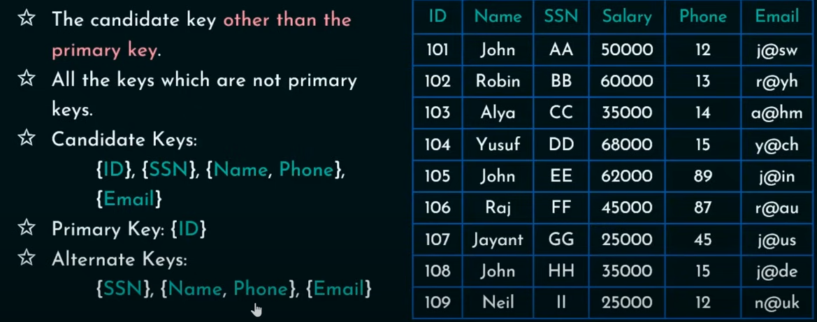
Secondary Key

Slide 20
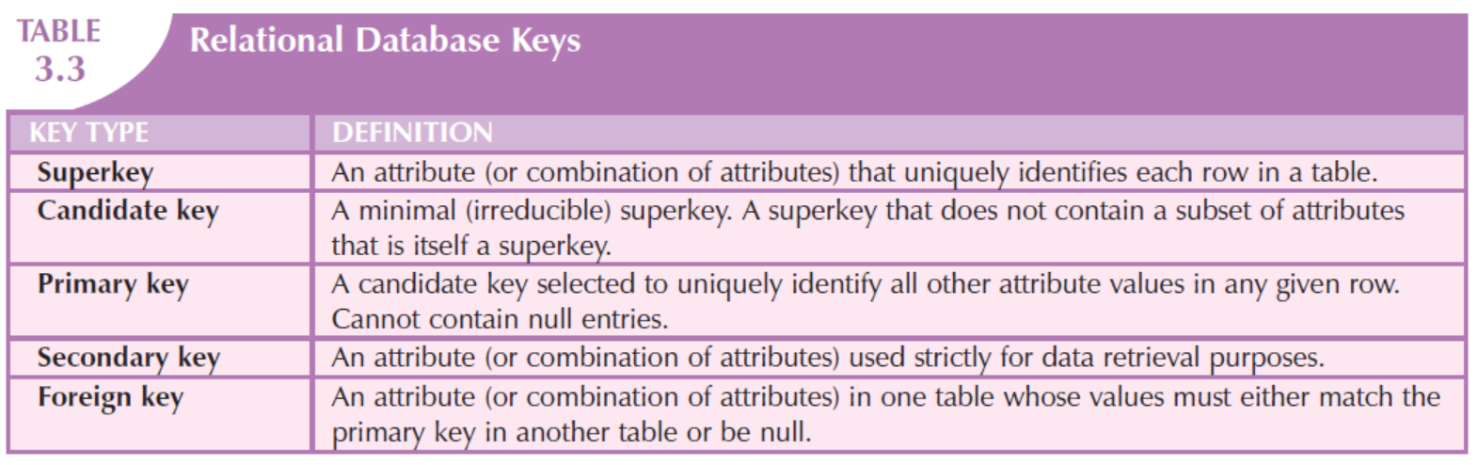
Summary Relational Database Keys

Slide 21
The data dictionary
a detailed description of all tables found within the user/designer-created database
contains at least all of the attribute names and characteristics for each table in the system
contains metadata—data about data

Slide 22
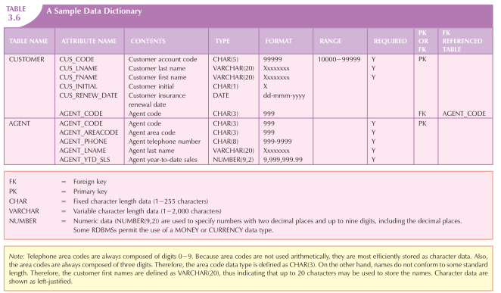
A sample data dictionary

Slide 23
Homonyms
similar-sounding words with different meanings, such as boar and bore
identically spelled words with different meanings, such as fair (meaning “just”) and fair (meaning “festival”)
C_NAME could be customer name or consultant name
you should avoid database homonyms

Slide 24
Synonym
indicates the use of different names to describe the same attribute
car and auto refer to the same object
Example: employee and teacher
Synonyms must be avoided

Slide 25
Referential Integrity
If the foreign key contains either matching values or nulls, the table that makes use of that foreign key is said to exhibit referential integrity.
In other words, referential integrity means that if the foreign key contains a value, that value refers to an existing valid tuple (row) in another relation.

